Slide 1
The philippines
Nicole caicedo

Slide 2
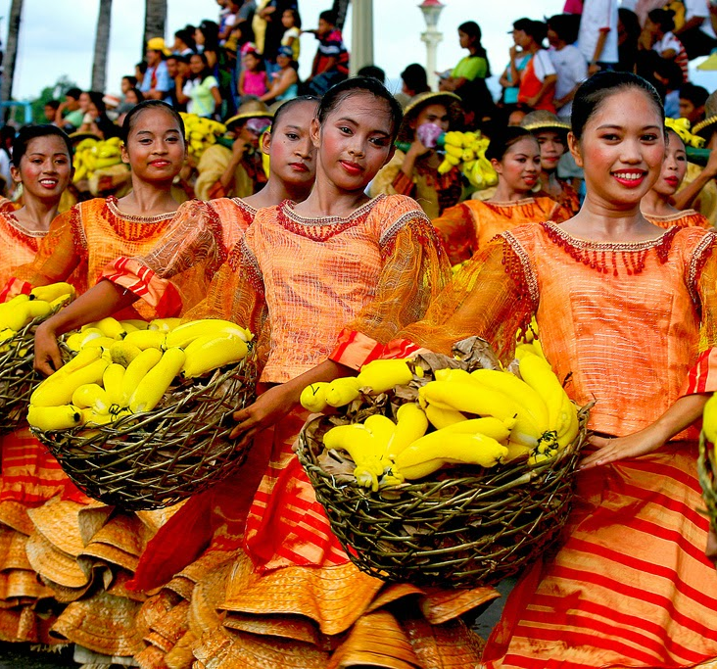
culture
Colonized by the Spaniards and then by the Americans after the Spanish-AMerican war. They became fully independent July 4, 1946

Slide 3
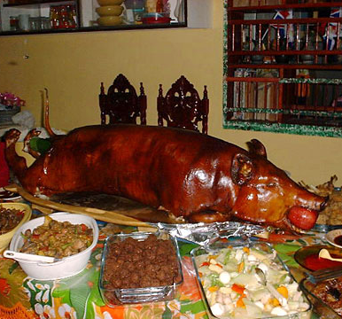
lechon
Traditional food that is eaten on special occasions in the Philippines
Ex: Holidays, weddings, etc.

Slide 4
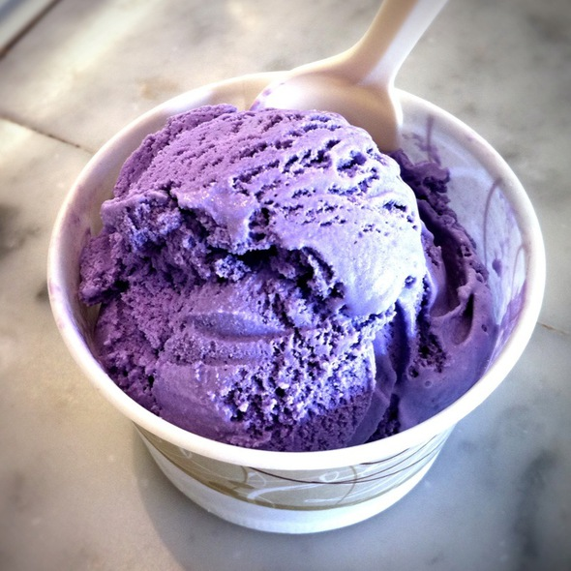
dessert
Some dessert in the Philippines include Ube. Using a purple potato that is put into cakes or ice cream for the color.

